Slide 1


Slide 2
Introduction
Dataset contains details about Netflix movies and shows
Data from 1970 to 2021
~8k Records
Exploratory Data Analysis
Country of Origin
Release Year
Genre
Rating

Slide 3
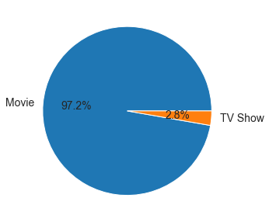
Movies are more frequently released on Netflix

Slide 4
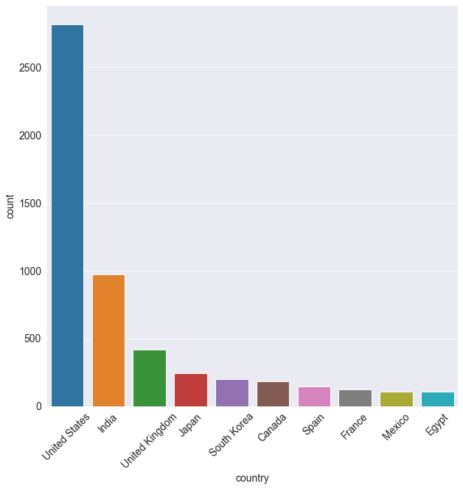
Most of the movies originated from US

Slide 5
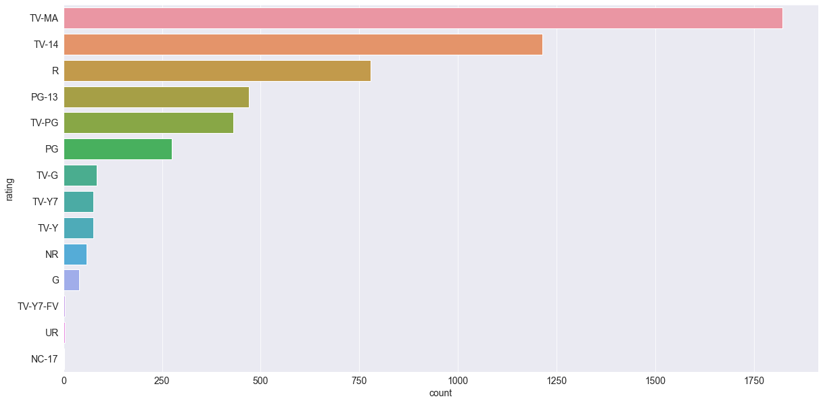
TV-MA rated movies were mostly released in recent years

Slide 6
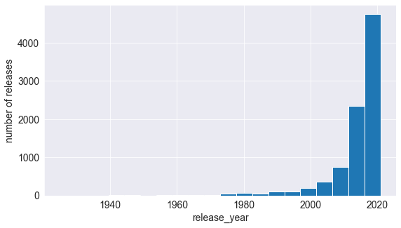
Maximum number of movies and shows were released between 2015 and 2020

Slide 7
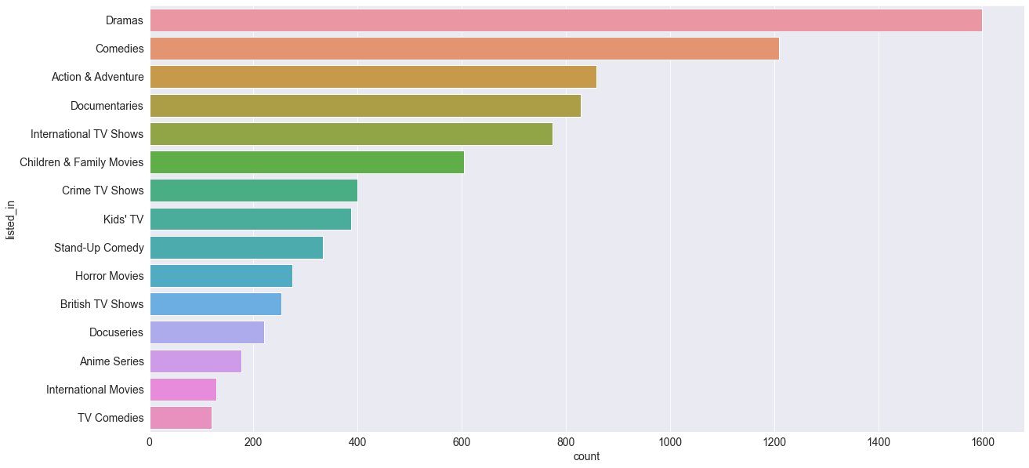
Dramas were the most popular type of movie genre streamed on Netflix

Slide 8
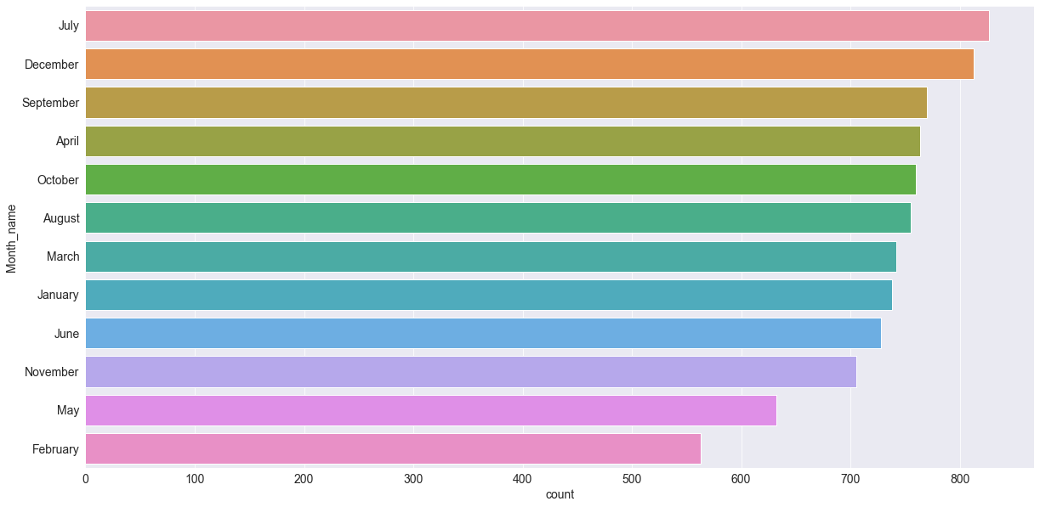
July and December are the most suitable months for releases

